Slide 1
Distributed Collaborative Key Agreement
Protocols for Dynamic Peer Groups
Guided By Dr. R.Shamugalakhsmi Ph.D.
By
Ganesh Karthick. R(0417111)
Prabhu. M
Rajesh Kumar. S
Mohan Kumar. P

Slide 2
Outline
Identify the motivations of group key
agreement and its requirements.
Introduce Tree-Based Group Diffie-Hellman (TGDH), which uses a key tree to arrange all the keys.
Propose interval-based rekeying algorithms.

Slide 3
Motivations
Many group-oriented and distributed applications require security services.
Example: a closed and confidential business meeting in a P2P network.
We therefore need a secure distributed group key agreement scheme so that the group can encrypt their communication data with a common secret group key.

Slide 4
Requirements of Group Key Agreement
Distributed: There is no centralized key server, which has the following limitations:
      A single point of failure; and
      Not suitable for peer groups and ad hoc networks.
Collaborative: All group members contribute their own part to generate a group key.
Dynamic: The protocol remains efficient even when the occurrences of join/leave events are very frequent.

Slide 5
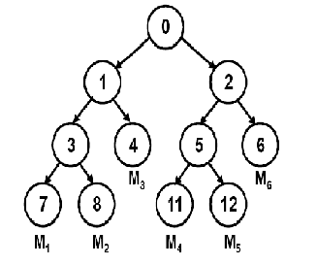
Tree-Based Group Diffie-Hellman
Protocol (TGDH)
A key tree is formed. Each node v represents a secret (private) key Kv and a blinded (public) key BKv.
BKv = α^{Kv} mod p, where α and p are public parameters.
Every member holds the secret keys along the key path, and all the blinded keys in the key tree.
K₀ is the group key.

Slide 6
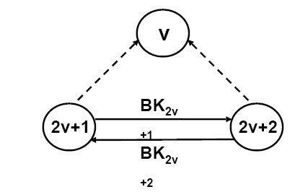
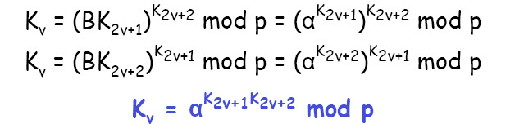
TGDH: Relationships between nodes
The secret key of a non-leaf node v can be generated by:
K_{v}=(Received Public Key) ^{(Own Private Key)} mod p

Slide 7
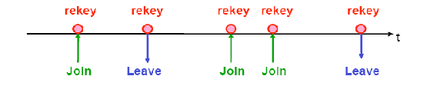
TGDH: Handle membership events
Rekeying (renewing the keys of the nodes) is performed for every single join/leave event to ensure backward and forward confidentiality.
A special member called sponsor is elected to be responsible for broadcasting updated blinded keys.

Slide 8
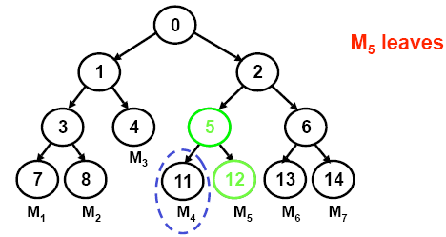
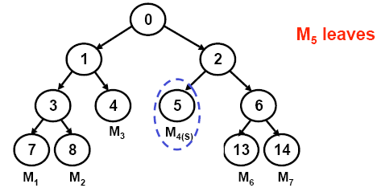
TGDH: Single Leave Case
M₅ is leaving.
Node 12 is pruned.
M₄ is promoted to Node 5 and acts has a sponsor

Slide 9
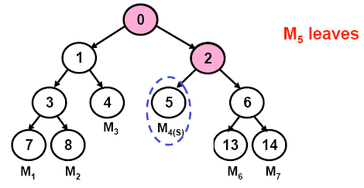
TGDH: Single Leave Case
M₄ becomes the sponsor. It rekeys the secret keys K₂ and K₀ and broadcasts the blinded key BK₂.
M₁, M₂ and M₃ compute K₀ given BK₂.
M₆ and M₇ compute K₂ and then K₀ given BK₅.

Slide 10
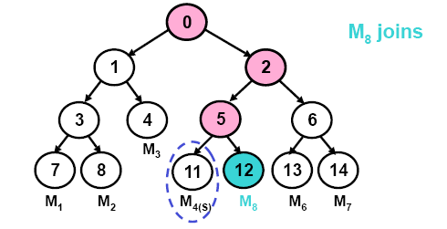
TGDH: Single Join Case
M₈ broadcasts its individual blinded key BK₁₂ on joining.
M₄ becomes the sponsor again. It rekeys K₅, K₂ and K₀ given BK₁₂ and broadcasts the blinded key BK₅ and BK₂.
Now everyone can compute the new group key.

Slide 11
Interval-Based Rekeying Algorithms
We can reduce one rekeying operation if we can simply replace M₅ by M₈ in node 12.
Interval-based rekeying is proposed such that rekeying is performed on a batch of join and leave requests at regular rekey intervals.
Interval-based rekeying improves system performance, by reducing the number of rekeying operations.

Slide 12
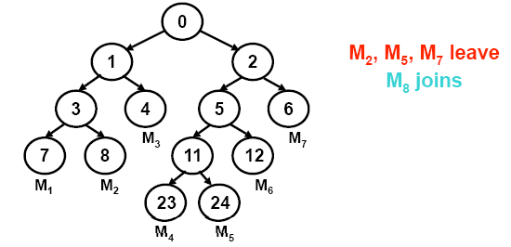
Rebuild Algorithm
Intuition: Minimize the final tree height so that the number of rekeying operations of every member is reduced.
Basic Idea: Reconstruct the whole key tree to form a complete tree.
We can explore under which workload Rebuild is good.

Slide 13
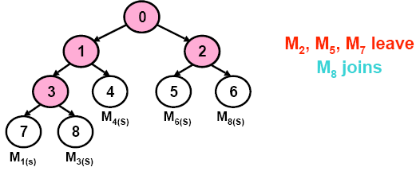
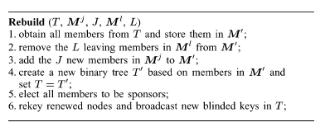
Rebuild Algorithm

Slide 14
Queue-batch Algorithm
Intuition:
The previous approach performs rekeying at the start of every rekey interval, leading to a heavy processing workload at the update instance.
Reduce the load by pre-processing the join events during the idle rekey interval

Slide 15
Queue-batch Algorithm
Two stages: Queue-sub tree and Queue-merge.
Queue-sub tree: Within the idle rekey interval, form a sub tree T’ with all joining members, just like individual rekeying for a single join event.
Queue-merge: At the beginning of the next rekey interval, prune all departed leaf nodes if any and add the sub tree T’ to the highest leave position (or attach T’ to the shallowest position).
Elect the sponsors who can help broadcast the new blinded keys.

Slide 16
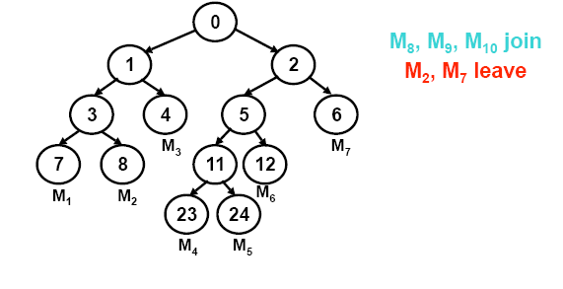
Queue-batch Example

Slide 17
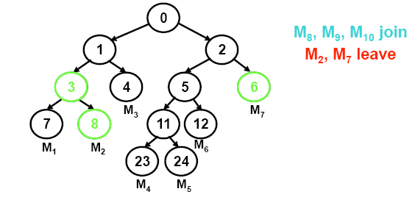
Queue-batch Example
Nodes which are affected by M₂ and M₇ leaving have been highlighted.

Slide 18
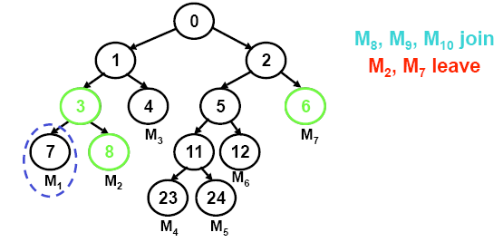
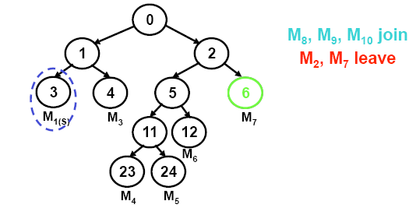

Queue-batch Example
The two figures show pruning of M₂.
Node 8(M₂) is removed.
M₁ is chosen as sponsor and promoted to node 3.

Slide 19
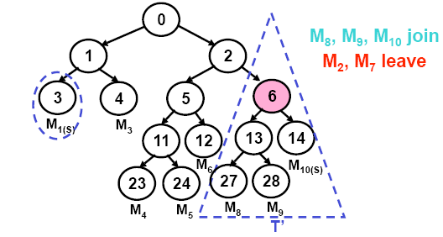
Queue-batch Example
The figure shows the new key tree.
The triangle shows sub tree T’ constructed during the idle rekeying interval.
The sub tree T’ is attached to shallowest portion of the original key tree T.

Slide 20
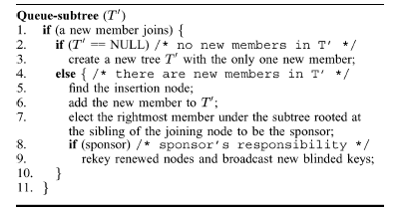
Queue-batch

Slide 21
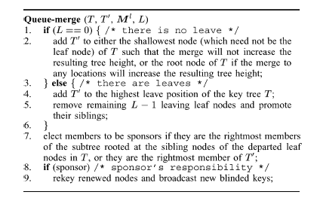
Queue-batch

Slide 22
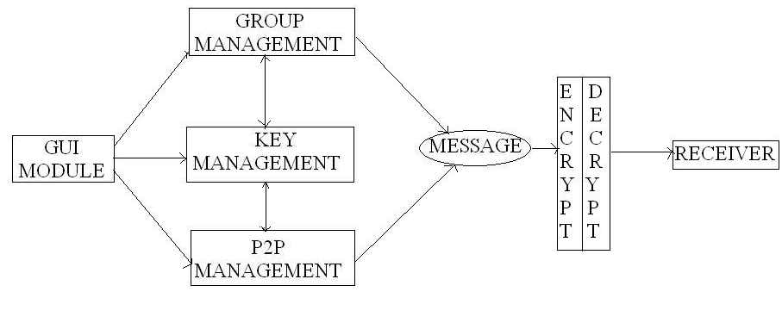
DESIGN AND IMPLEMENTATION
We have developed a Distributed Messenger Application with group management facilities.
The figure shows the design of the project consisting of 5 modules.

Slide 23
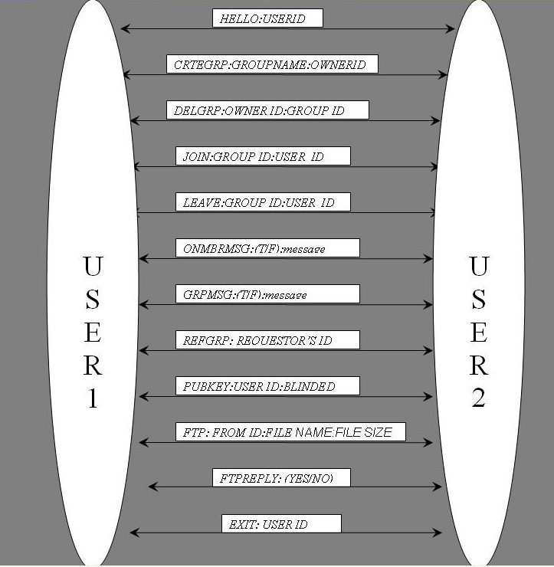
COMMUNICATION PROTOCOL

Slide 24
COMMUNICATION MANAGEMENT
Send class is responsible for sending messages to users. It provides methods to sending point to point messages, multicast and broadcast messages, also handling messages for offline users.
Receive class responsible receiving messages sent to the user. It also processes all the messages received. It runs separate thread of control to receive all the messages.

Slide 25
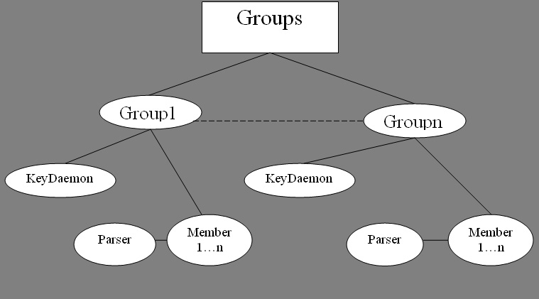
GROUP MANAGEMENT
Groups class is a collection of groups, provides facilities for group management functions.
Group class contains indiviual members, also maintains the control of key daemon.
Member represents indiviual user.
Parser helps in relating member related information form user id

Slide 26
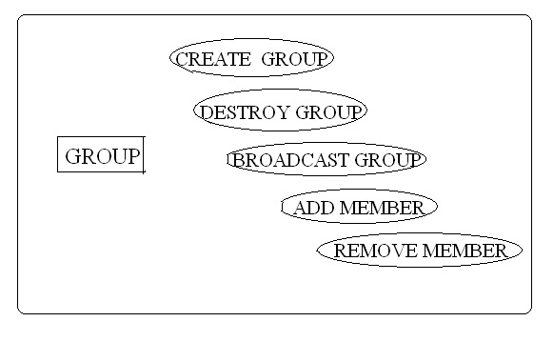
GROUP MANAGEMENT
Create Group call broadcasts the group Id of the new group, so that interested members can give join request.
Destroy Group will delete the group, informing all the members that the group has removed.
Broadcast Group will broadcast members of the group to the members who have been newly added.
Add and Remove member is used when a member joins or leaves a group.

Slide 27
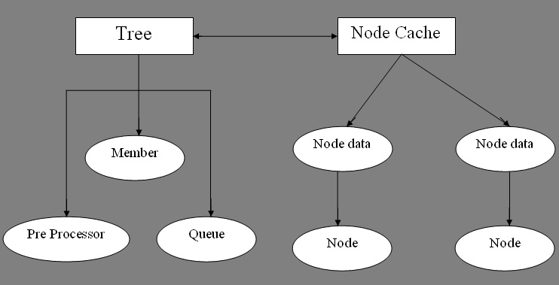
KEY MANAGEMENT
Tree class constructs tree using an instance of nodes class. It provides methods to find the shallowest point in the key tree.
Nodecache class is responsible for maintaining the cached public values also provides cache maintenance.
Preprocessor used for constructing temporary tree in queue batch algorithm

Slide 28
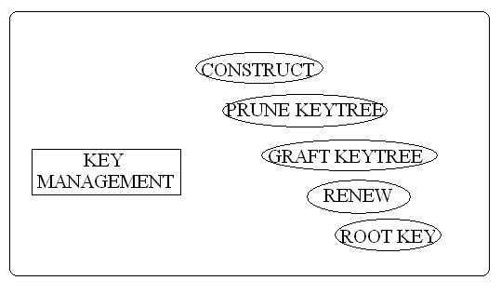
KEY MANAGEMENT
Construct is used to construct the key tree from member nodes.
Pruning is done to delete paths from removed members.
Grafting is used to create new paths for newly joined members.
Renew is used perform mod operations.
Root key represents the K_{o} used to perform group communication.

Slide 29
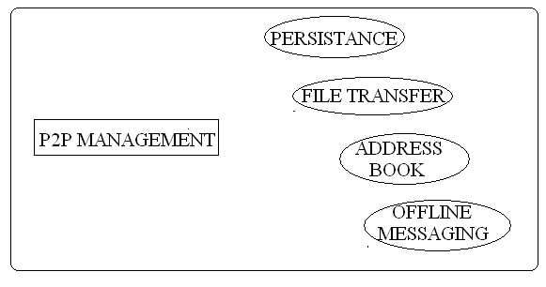
Peer to Peer Management
Providing persistent environment for each user i.e., the groups which they are part of and the members of groups are saved, when the user logs off.
Providing File Transfer and address book facility for each user.
Providing a facility for handling offline messages, so that users can send messages to other users who are not online.

Slide 30
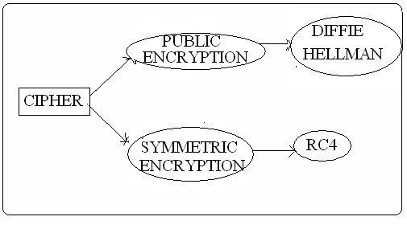
CIPHER MANAGMENT
Cipher is root class.
Symmetric and Public cipher have been created by extending cipher.
They contain abstract methods for encryption and decryption.

Slide 31
ENCRYPTION/DECRYPTION
Reasons for Choosing RC4.
It’s a Stream Cipher.
Thus suited for group services such as video conferencing.
Fast Execution.
Cipher | Key Length | Speed (Mbps)
DES | 56 | 9
3DES | 168 | 3
RC2 | variable | 0.9
RC4 | variable | 45

Slide 32
Evaluations
Performance
Number of renewed nodes: a renewed node refers to a non-leaf node whose keys are renewed. This metric provides a measure of the communication cost.
Number of exponentiation operations: this metric provides a measure of the computation load.
Interval based algorithms offers the best performance, and a significant computation/communication reduction when the group is very dynamic, compared to individual rekeying.

Slide 33
Advantages
In centralized key management, all its exponentiations are carried out within the single group controller, while our interval-based algorithms scatter the computational load among all group members.
The interval-based algorithms have better fault tolerance by eliminating the single-point-of-failure problem inherent in the centralized approach.
Number of rekeying operations is reduced.

Slide 34
APPLICATIONS
Group Video Conferencing
Multi player Online Games
Messenger

Slide 35
THANK YOU

